Slide 1
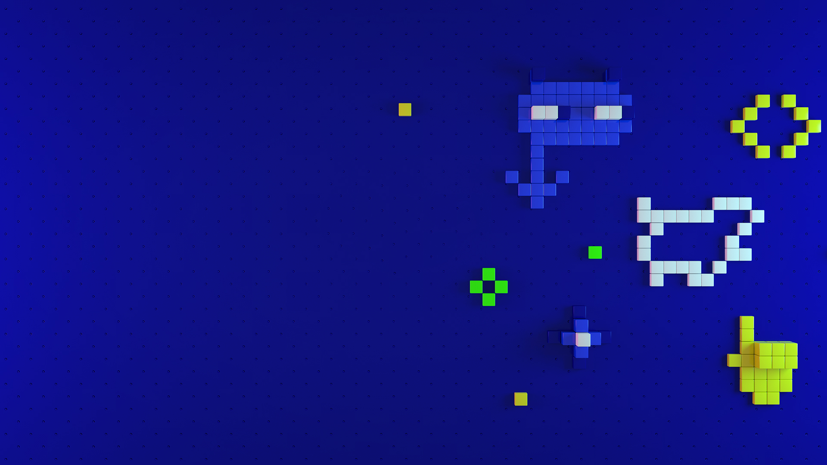
TJ VanToll 10 Awesome Things You Can Build with NativeScript
Tue, 22 Oct | 10:30 AM – 11:20 AM Gamma Room

Slide 2
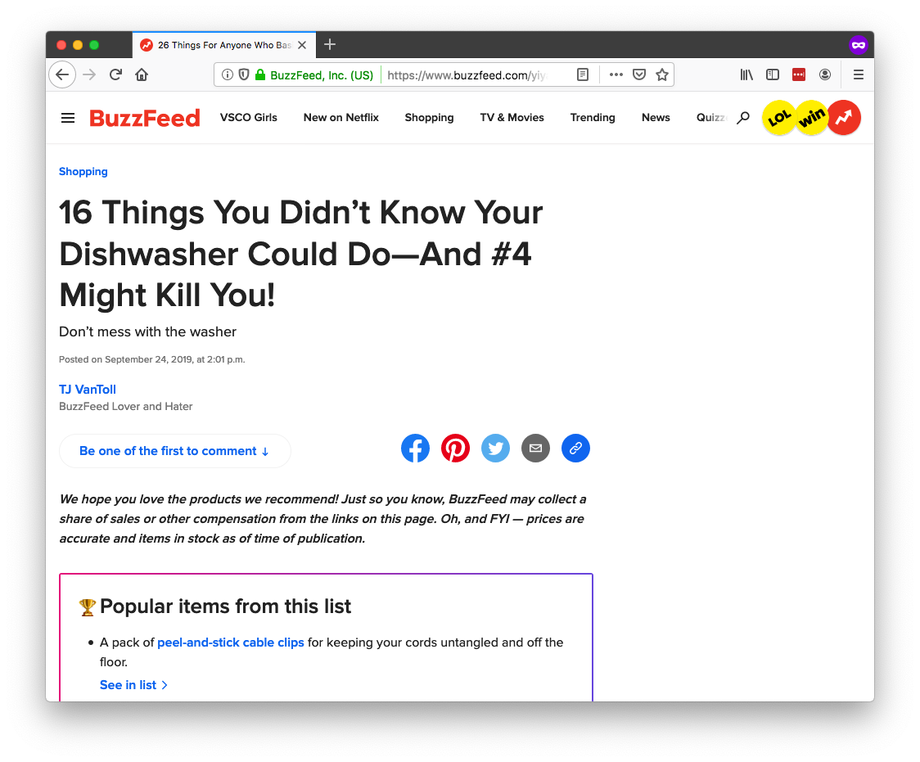

Slide 3
10 Awesome Things You Can Build With NativeScript

Slide 4
💡

Slide 5
📖

Slide 6
Slides: https://bit.ly/top-10-slides
Demo: https://bit.ly/top-10-demo

Slide 8
NativeScript 101
Build cross-platform iOS & Android apps
Build with JavaScript
CSS for app styling
Optionally use TypeScript
Optionally use JS frameworks like Angular and Vue.js
Free and open source
Makes it easy to build native UI and use native APIs

Slide 9
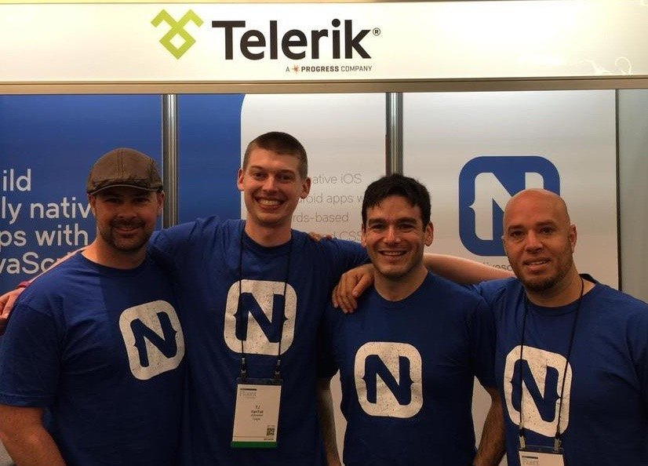


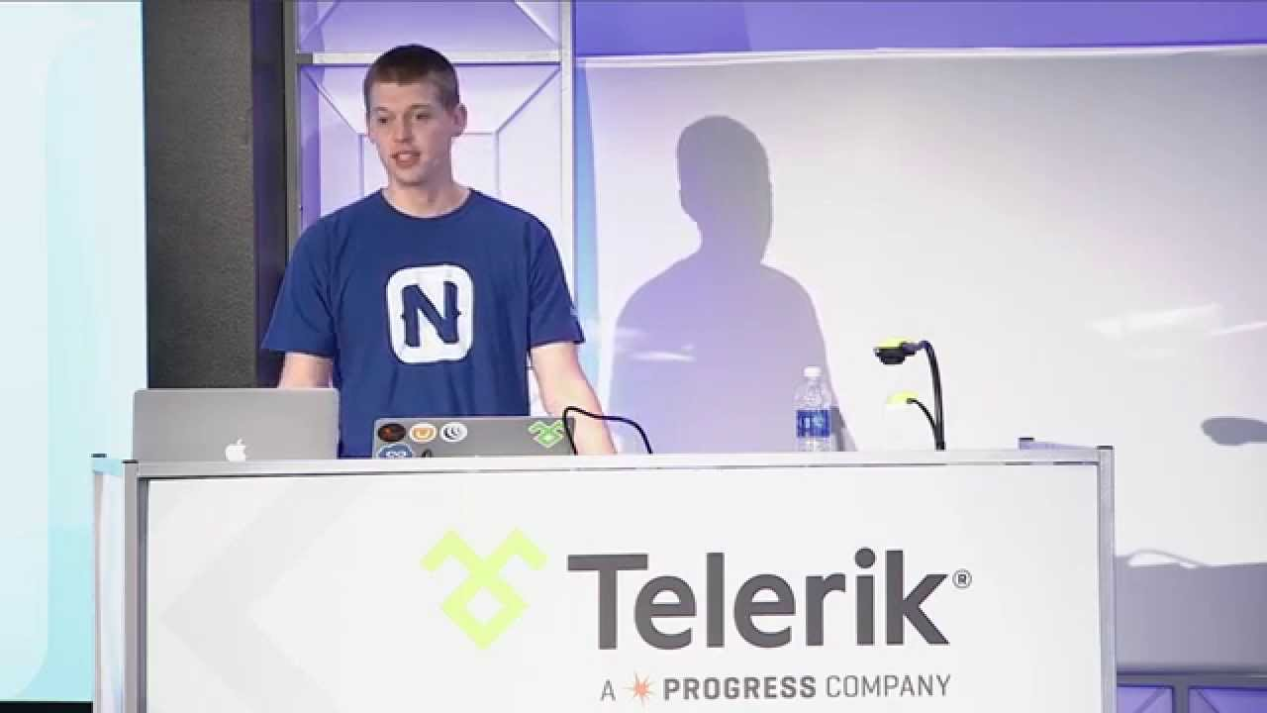

Slide 10
Agenda
Pragmatic
Biometric Auth, Maps & Geolocation, Code Sharing, Animations
Useful
AppSync, Bluetooth, Wearables, Native API access
Fun
Machine Learning, AR

Slide 11
Agenda
Pragmatic
Biometric Auth, Maps & Geolocation, Code Sharing, Animations
Useful
AppSync, Bluetooth, Wearables, Native API access
Fun
Machine Learning, AR

Slide 12
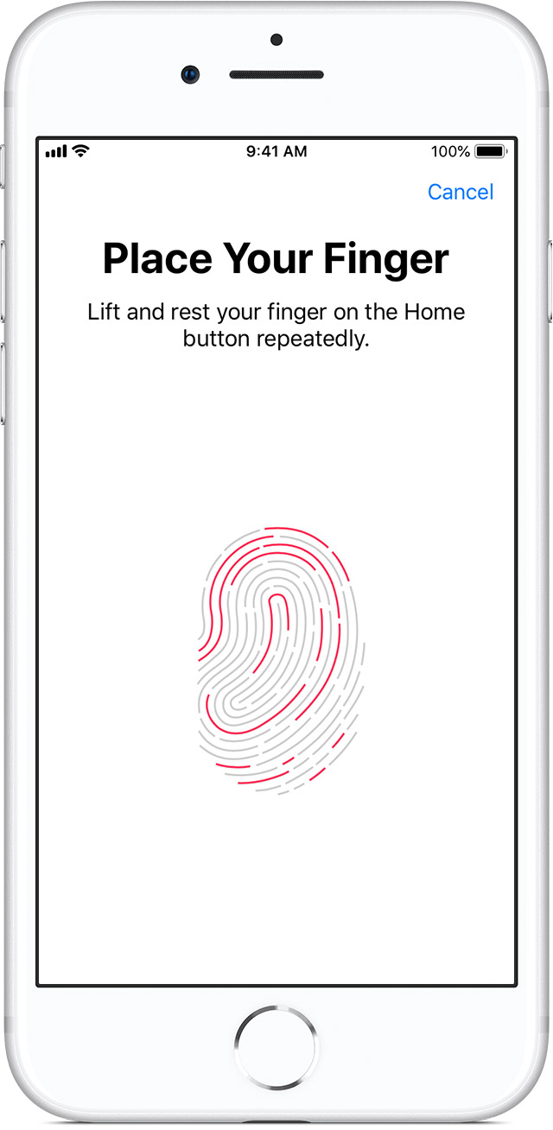
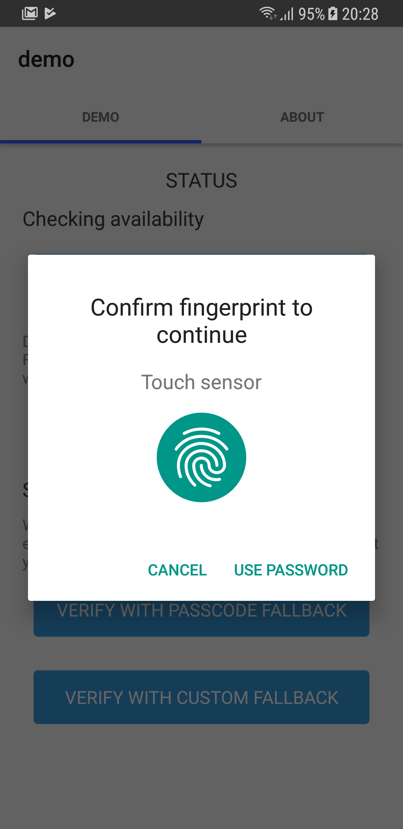
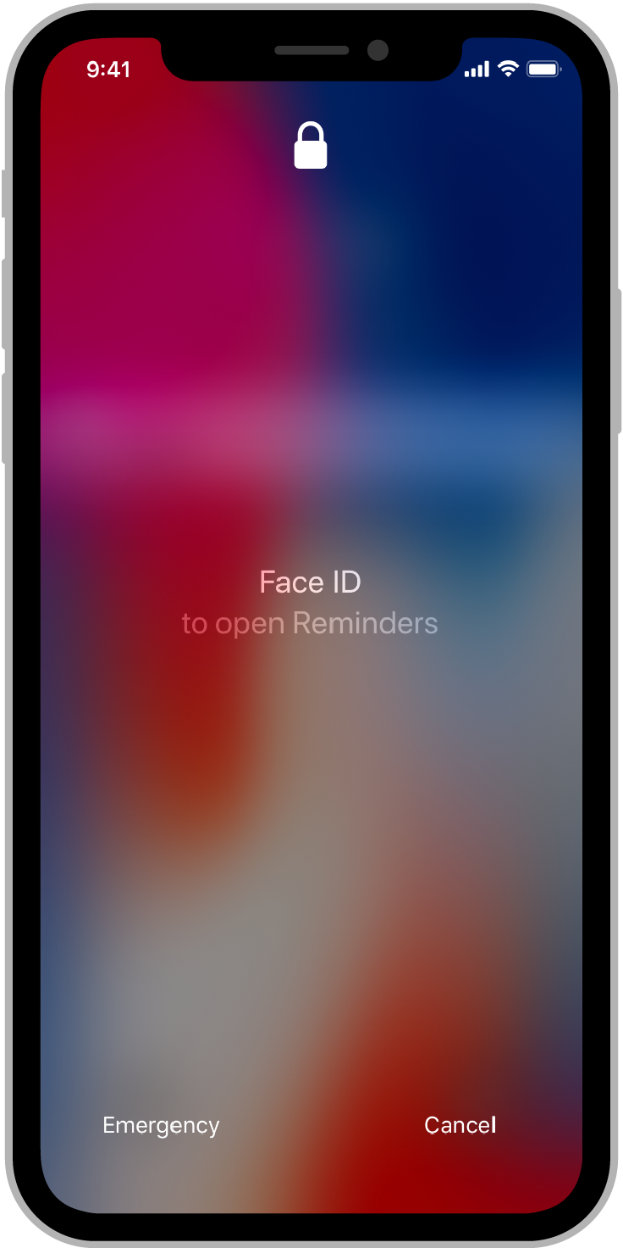
#1: Biometric auth

Slide 13
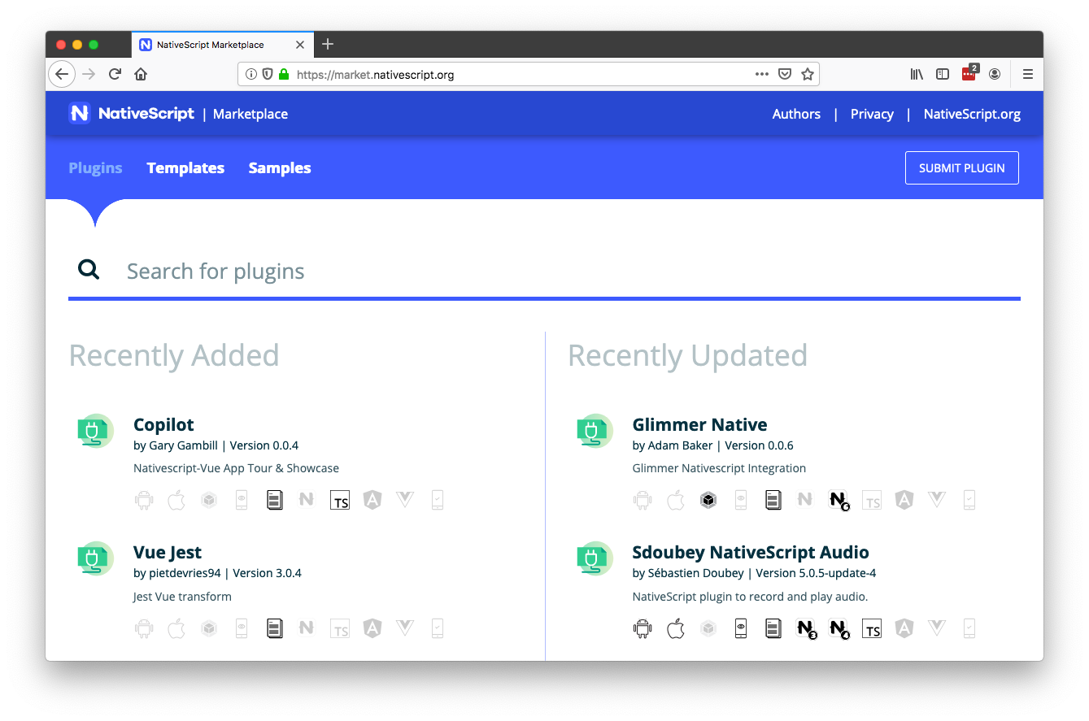

Slide 14
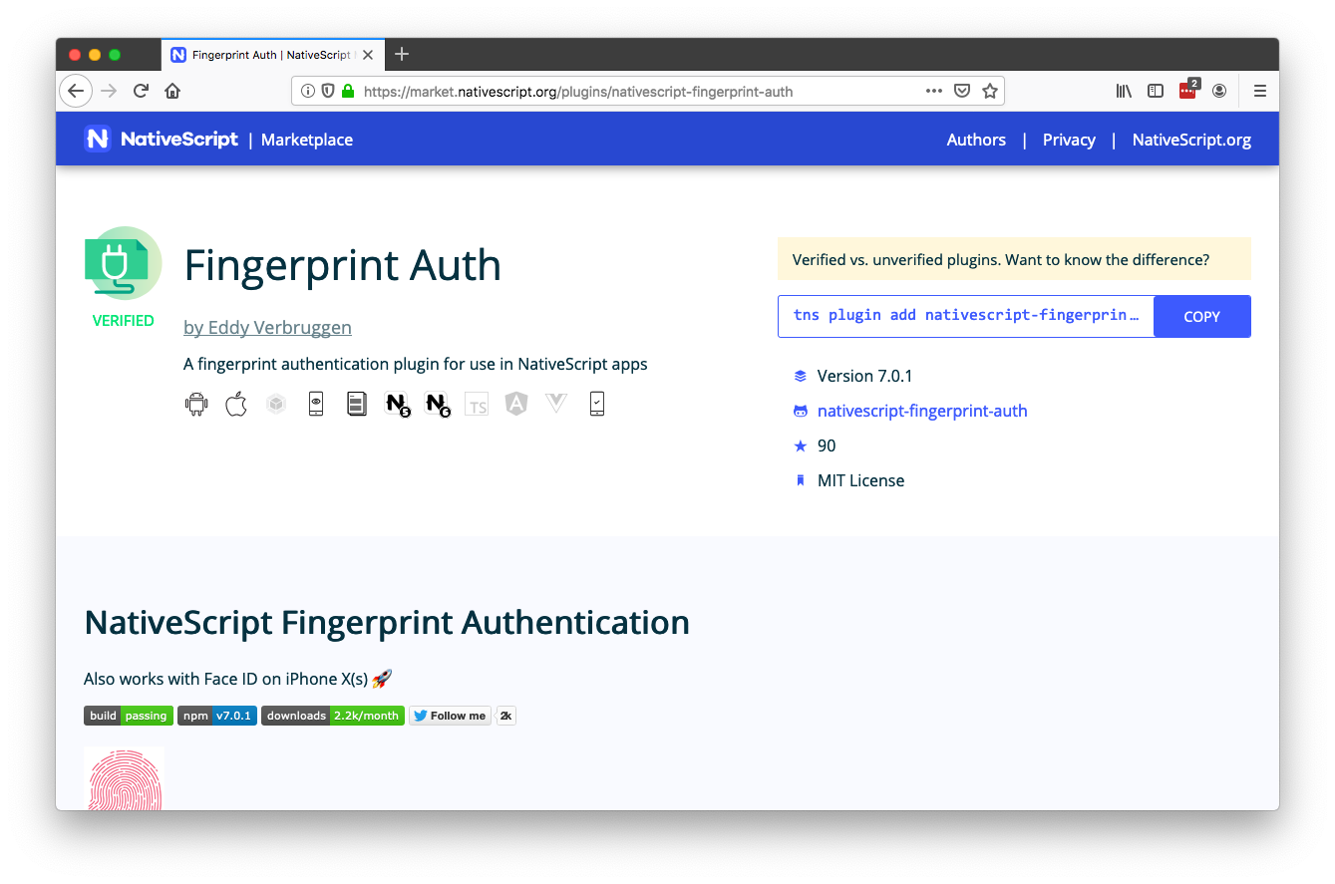

Slide 15
Biometric auth resources
Plugin: https://github.com/EddyVerbruggen/nativescript-fingerprint-auth
Article: https://www.progress.com/blogs/implementing-a-mobile-biometric-authentication-system-for-enterprise-applications

Slide 16
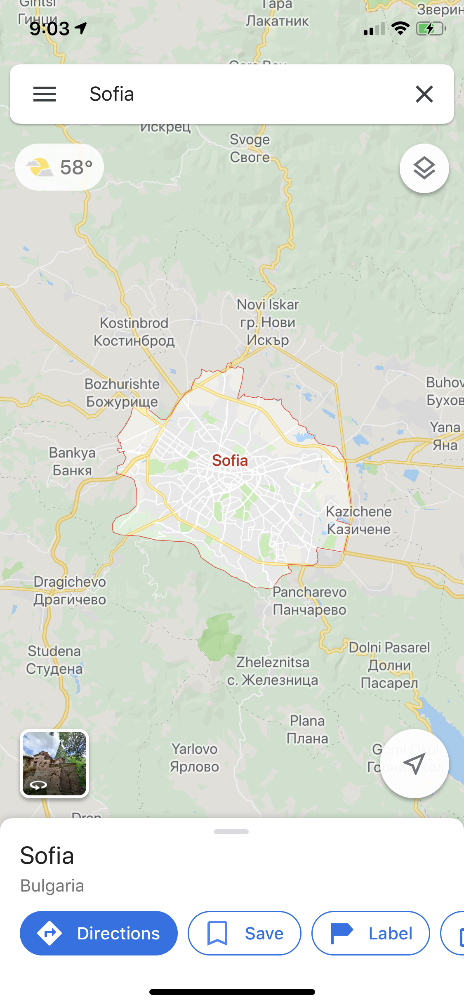
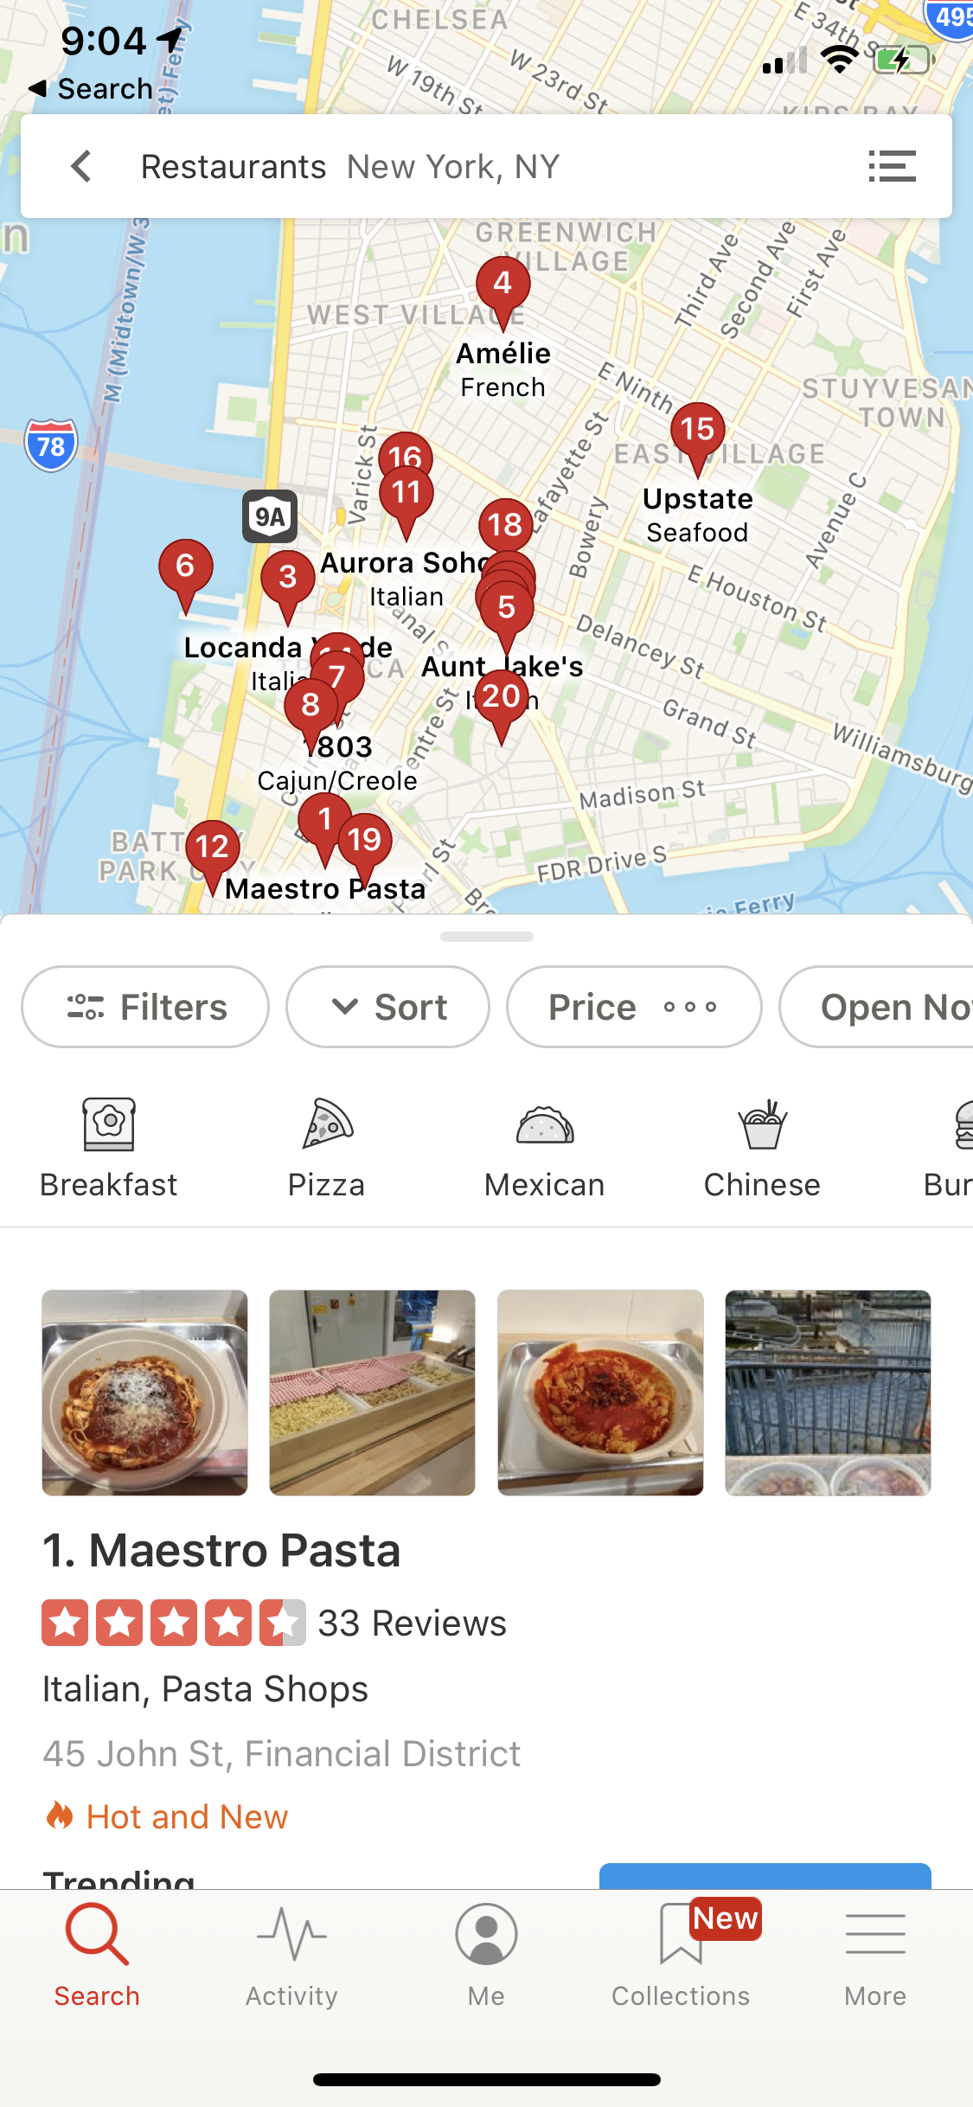
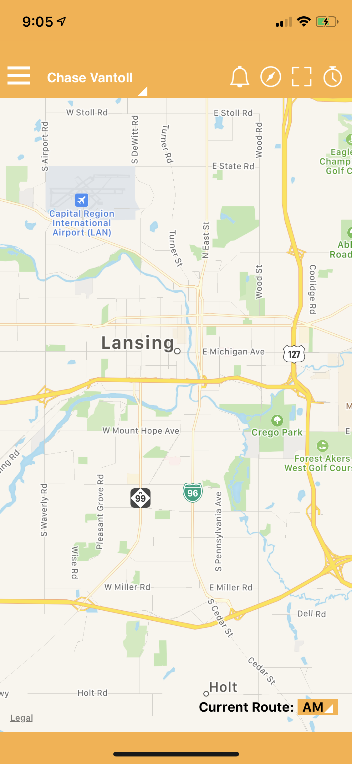
#2: Maps & geolocation

Slide 17
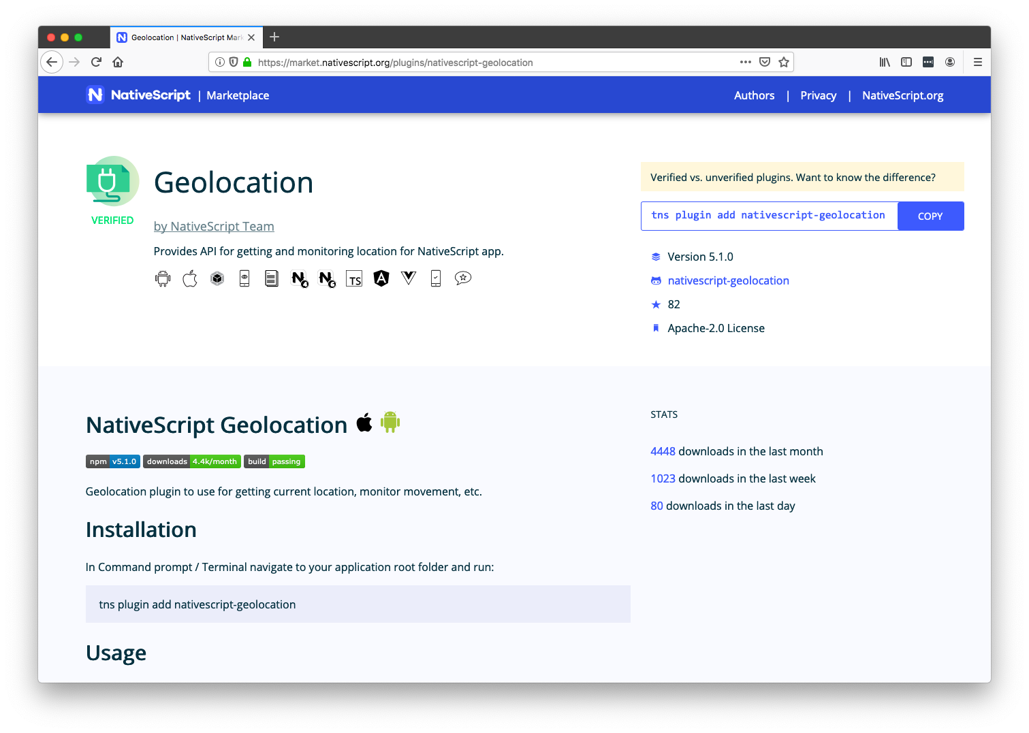

Slide 18
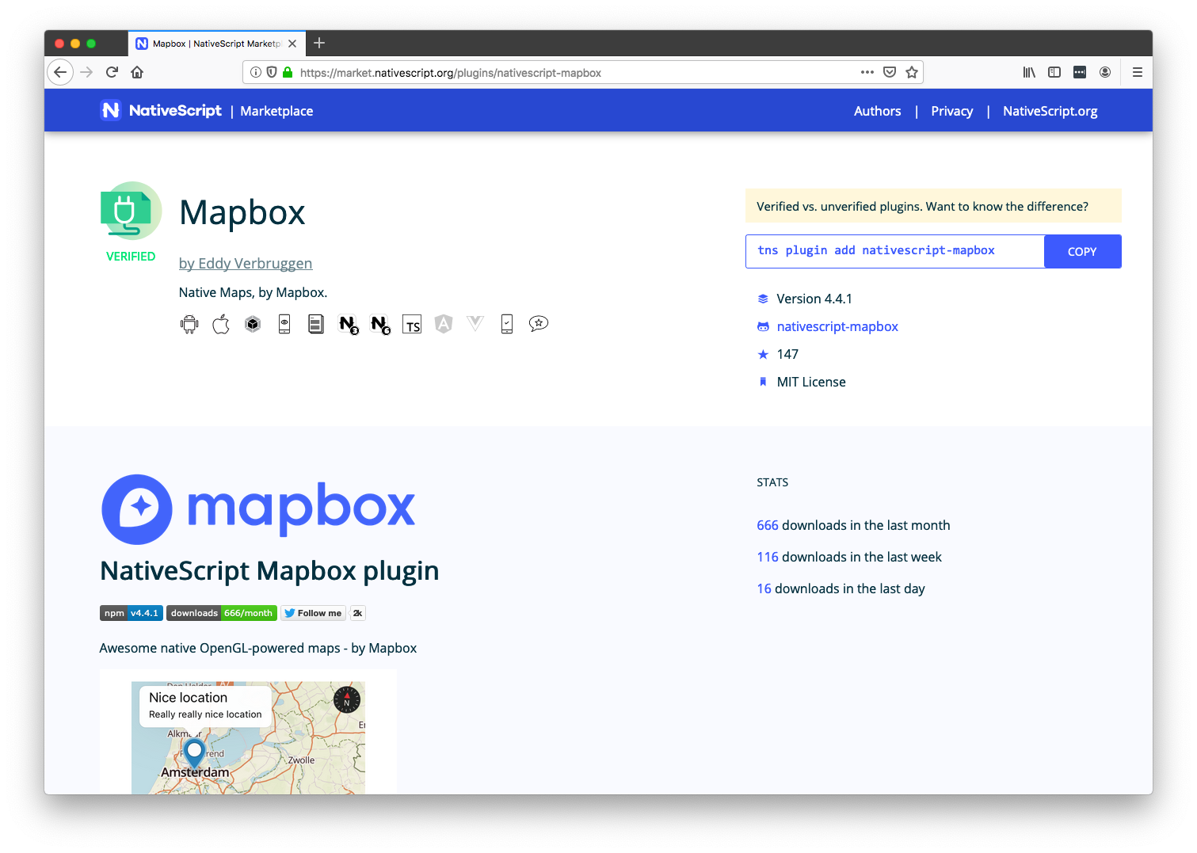

Slide 19
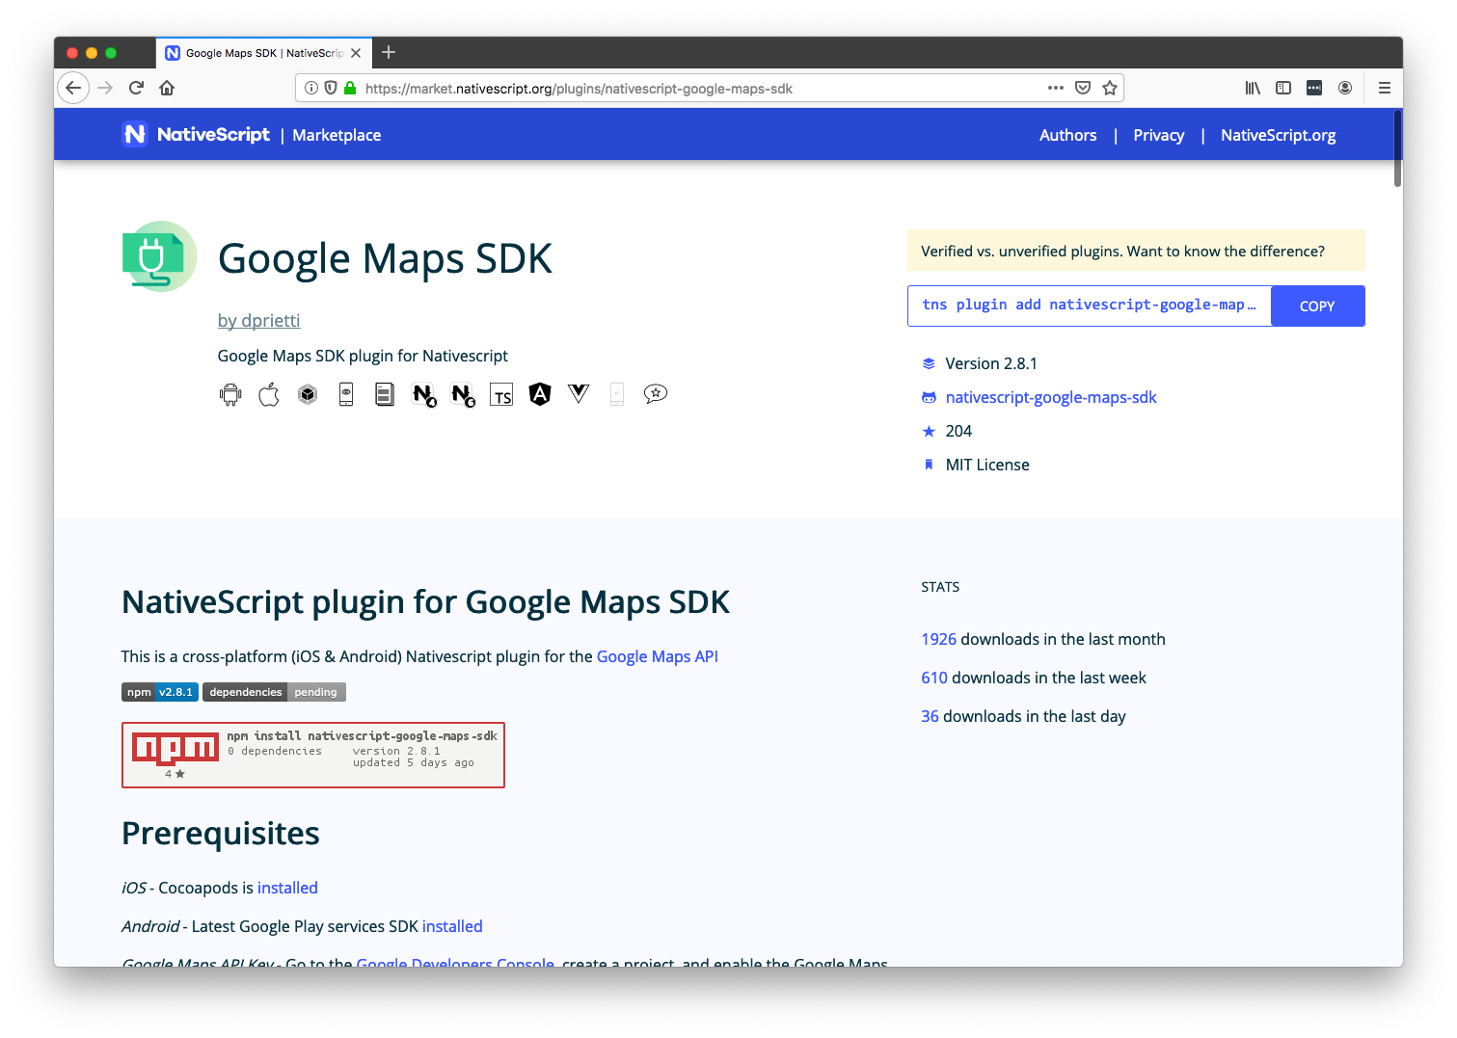

Slide 20
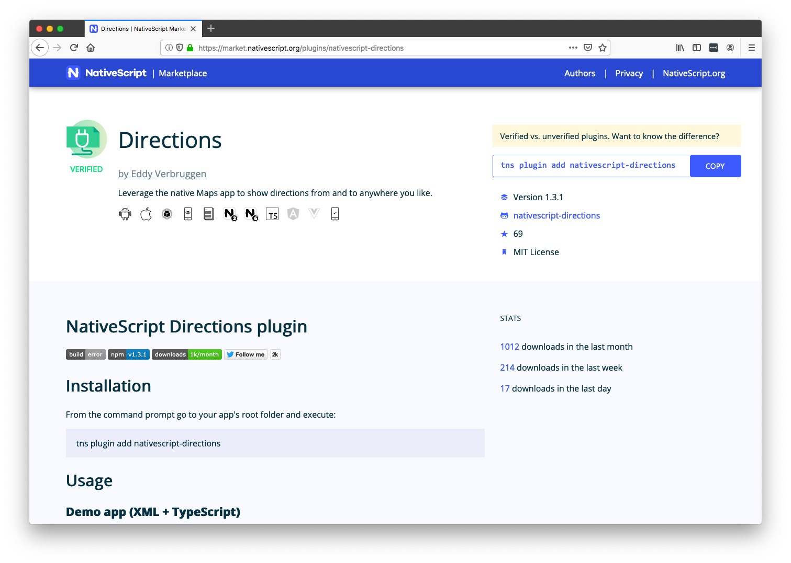

Slide 21
Maps & geolocation resources
https://market.nativescript.org/plugins/nativescript-geolocation
https://market.nativescript.org/plugins/nativescript-mapbox
https://market.nativescript.org/plugins/nativescript-google-maps-sdk
https://market.nativescript.org/plugins/nativescript-directions

Slide 22
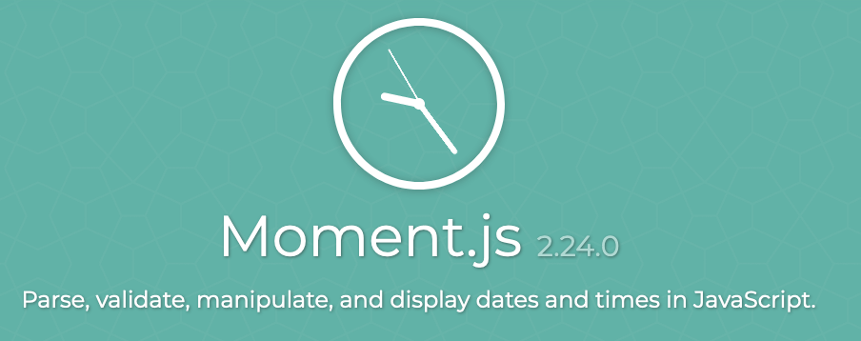



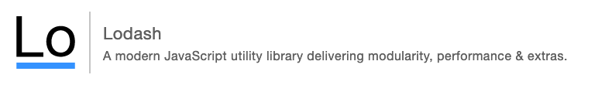
#3: Code sharing

Slide 23
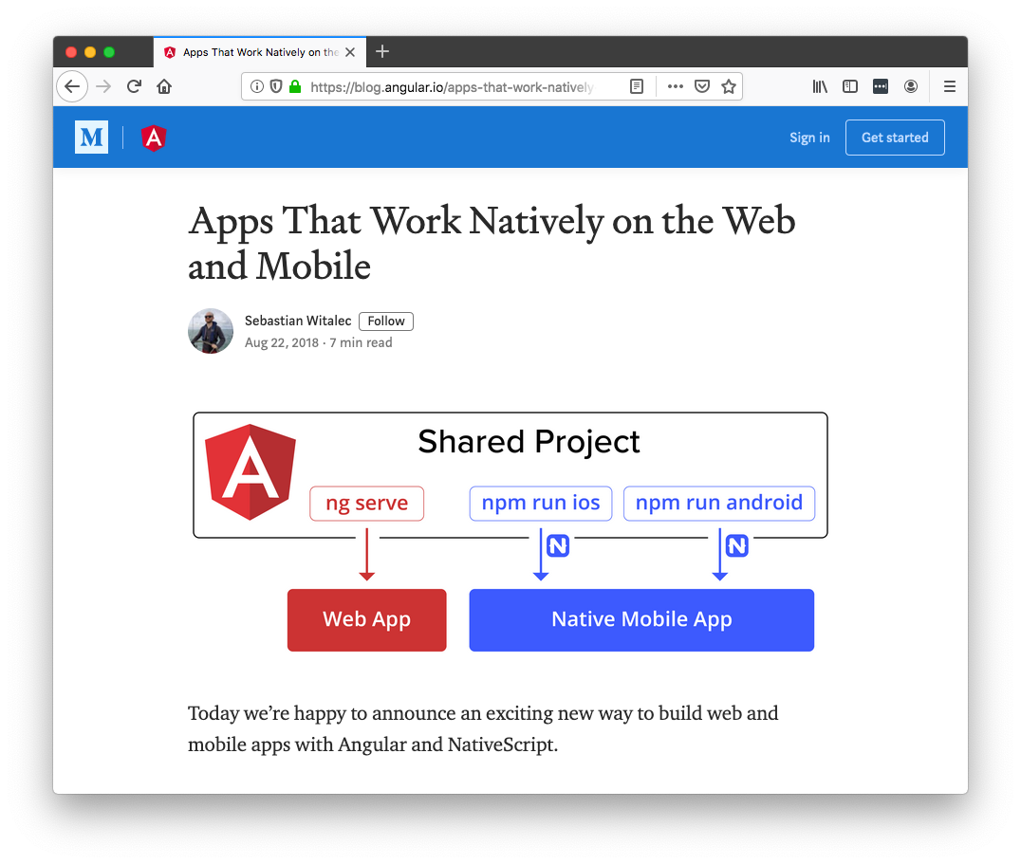

Slide 24
Code sharing resources
Introduction
https://www.nativescript.org/nativescript-is-how-you-build-native-mobile-apps-with-angular/code-sharing-angular-and-nativescript
Documentation
https://docs.nativescript.org/angular/code-sharing/intro
Sample
https://github.com/ignaciofuentes/nativescript-acme-sample/

Slide 25
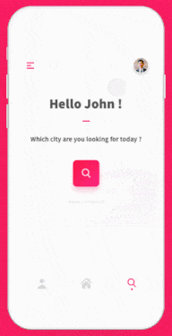
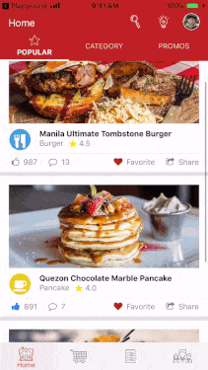
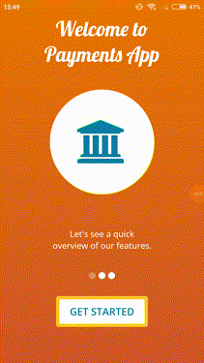
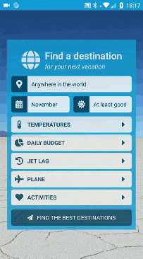
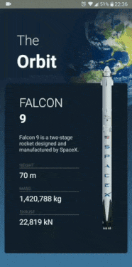
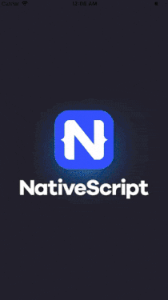
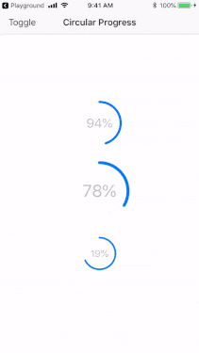
#4: Animations

Slide 26
Animations resources
Documentation
https://docs.nativescript.org/ui/animation
https://docs.nativescript.org/ui/components/frame
Lottie plugin
https://github.com/bradmartin/nativescript-lottie
Code samples
https://market.nativescript.org/?tab=samples&framework=all_frameworks&category=all_samples

Slide 27
Agenda
Pragmatic
Biometric Auth, Maps & Geolocation, Code Sharing, Animations
Useful
AppSync, Bluetooth, Wearables, Native API access
Fun
Machine Learning, AR

Slide 28
Agenda
Pragmatic
Biometric Auth, Maps & Geolocation, Code Sharing, Animations
Useful
AppSync, Bluetooth, Wearables, Native API access
Fun
Machine Learning, AR

Slide 29


#5: AppSync
Notes:
Show HMR in action

Slide 30



Slide 31
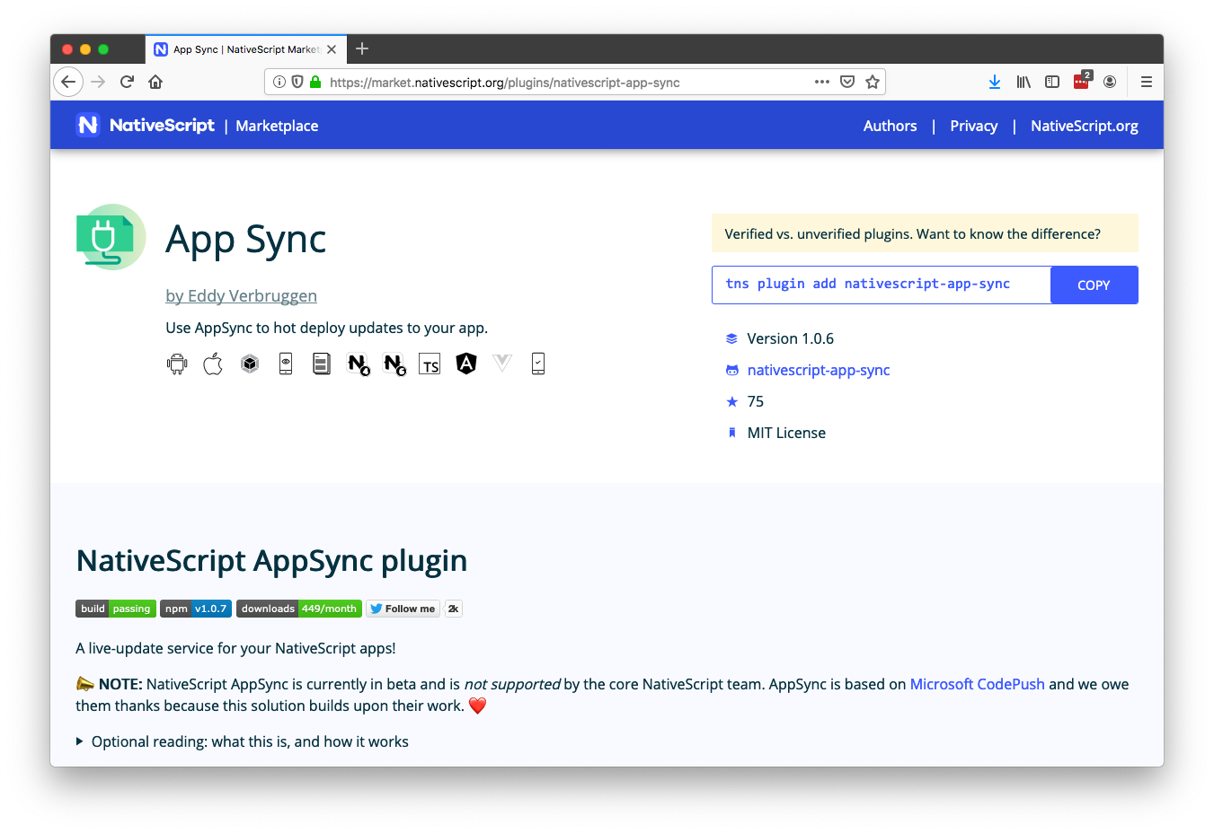
Notes:
```
nativescript-app-sync release Top10iOS ios
```

Slide 32
AppSync resources
Plugin:
https://market.nativescript.org/plugins/nativescript-app-sync
Article:
https://www.nativescript.org/blog/enable-live-updates-of-your-ios-and-android-apps-using-nativescript-appsync

Slide 33

#6: Bluetooth

Slide 34
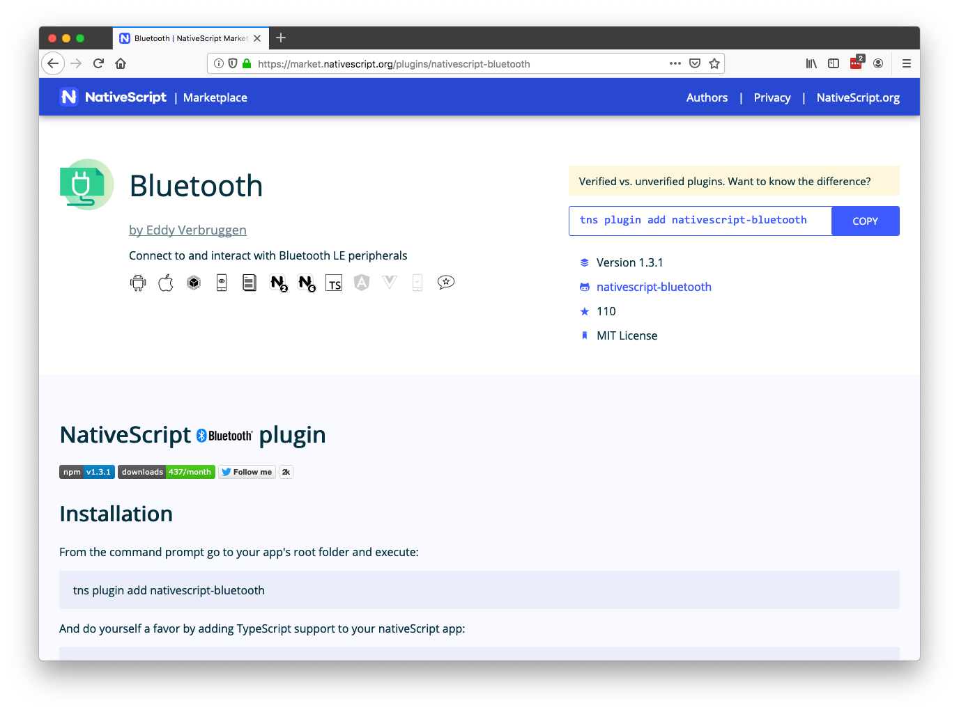

Slide 35
Bluetooth resources
Plugin
https://market.nativescript.org/plugins/nativescript-bluetooth
Article
https://www.nativescript.org/blog/controlling-robots-with-nativescript-bluetooth
Talk
https://www.youtube.com/watch?v=gRw0EMtpxlM

Slide 36
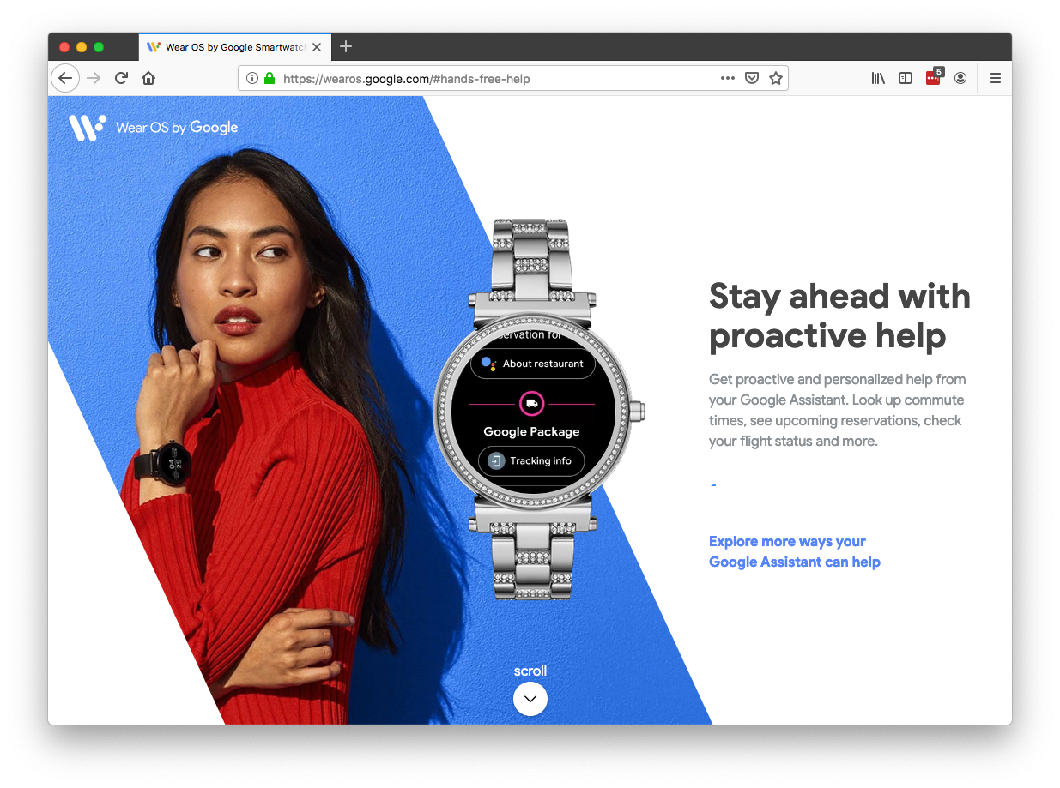
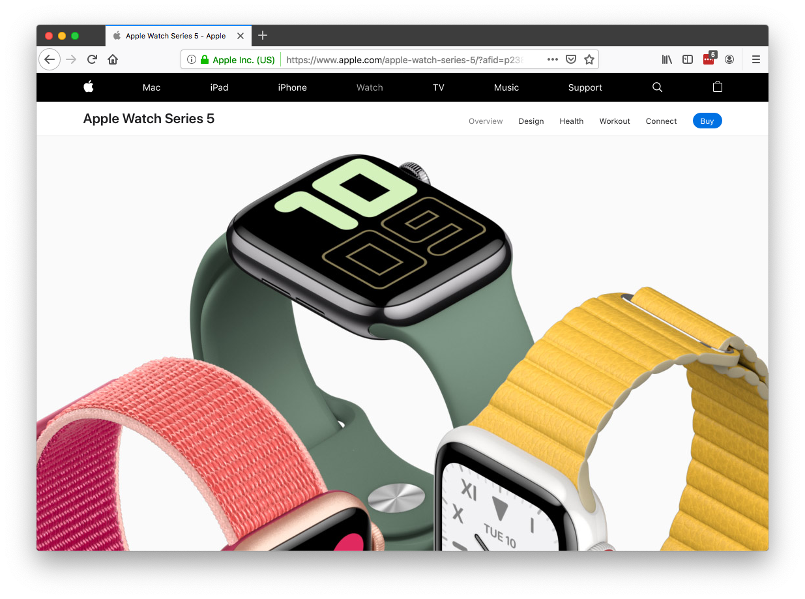
#7: Wearables

Slide 37
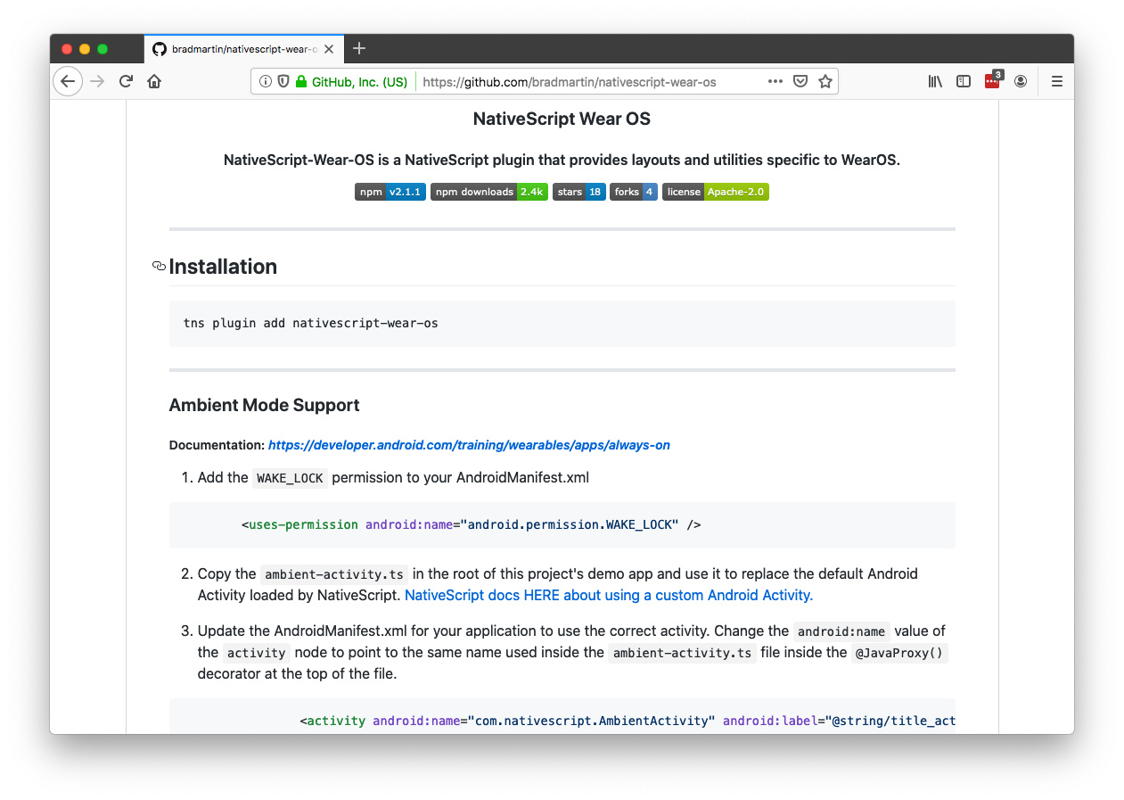

Slide 38
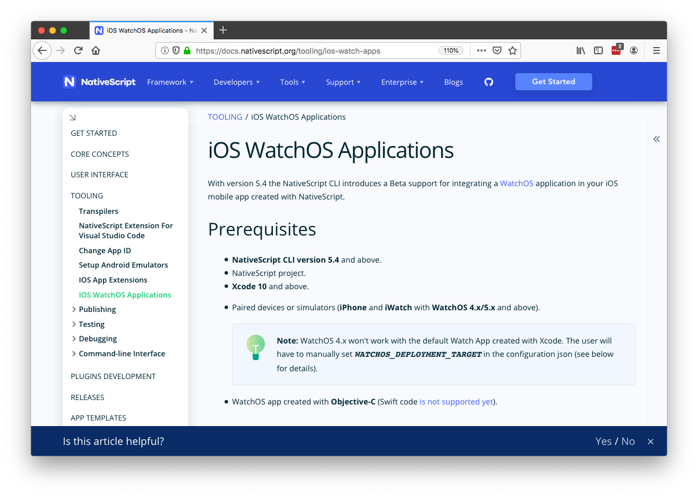

Slide 39
Resources
Wear OS plugin
https://market.nativescript.org/plugins/nativescript-wear-os
Apple Watch article
https://www.nativescript.org/blog/developing-a-watchos-extension-for-your-nativescript-app
Apple Watch documentation
https://docs.nativescript.org/tooling/ios-watch-apps

Slide 40
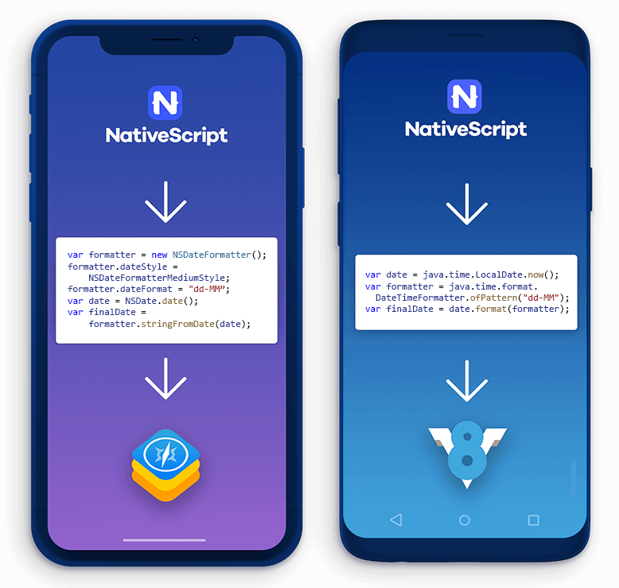
#8: Native API access

Slide 41
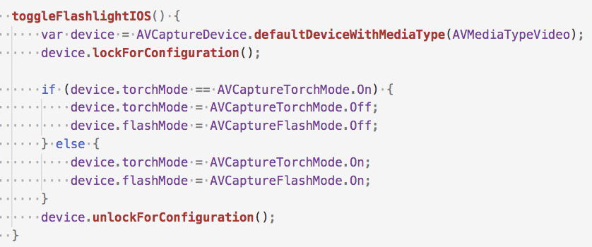

Slide 42
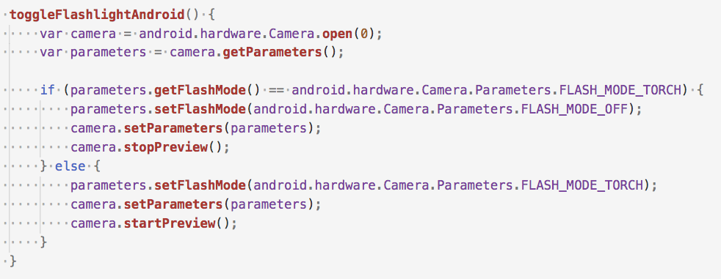

Slide 44
Resources
Documentation
https://docs.nativescript.org/core-concepts/accessing-native-apis-with-javascript
Video
https://www.youtube.com/watch?v=DGCUcqejsVk

Slide 45
Agenda
Pragmatic
Biometric Auth, Maps & Geolocation, Code Sharing, Animations
Useful
AppSync, Bluetooth, Wearables, Native API access
Fun
Machine Learning, AR

Slide 46
Agenda
Pragmatic
Biometric Auth, Maps & Geolocation, Code Sharing, Animations
Useful
AppSync, Bluetooth, Wearables, Native API access
Fun
Machine Learning, AR

Slide 47
#9: Machine learning
🤖

Slide 48


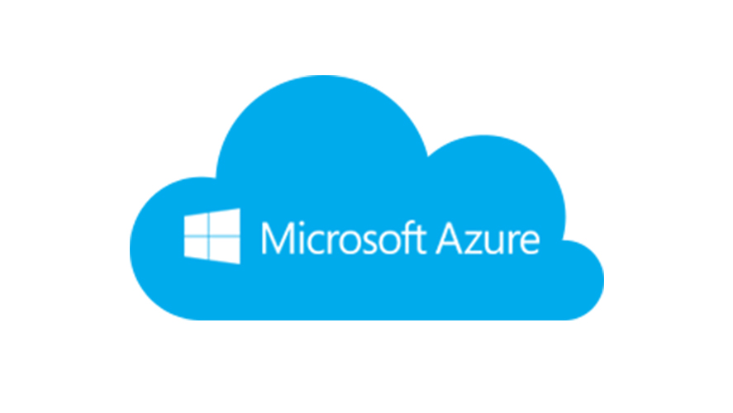


Slide 50
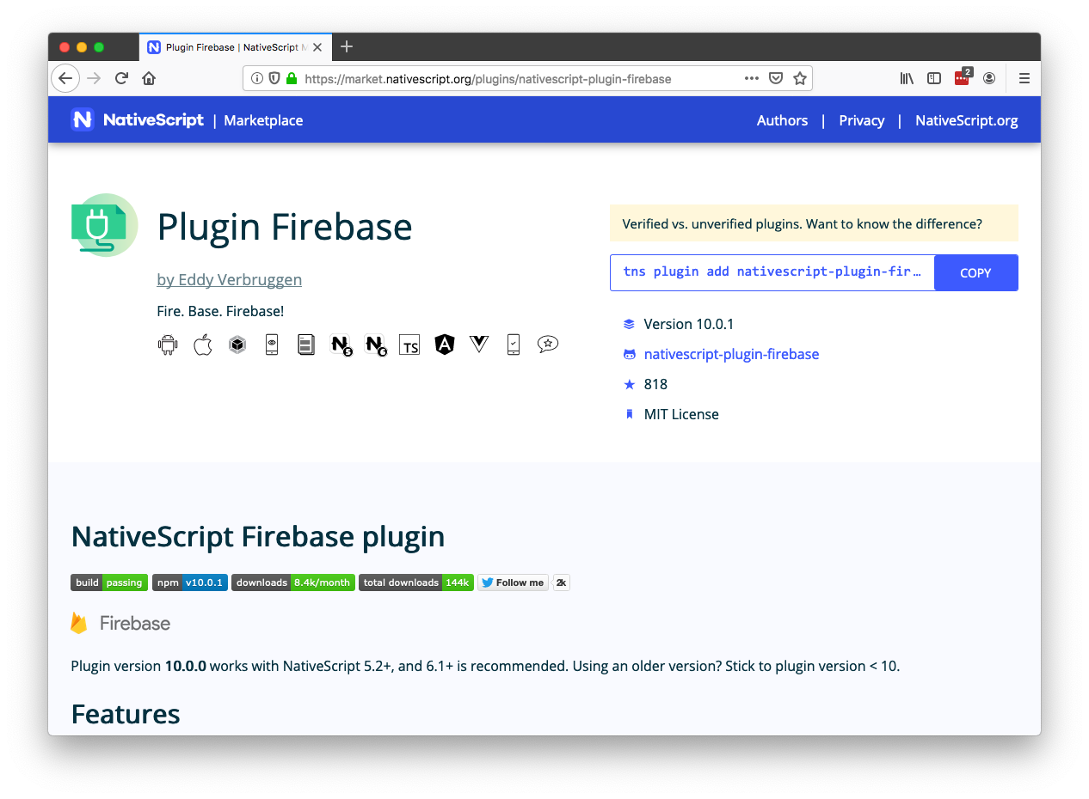

Slide 51
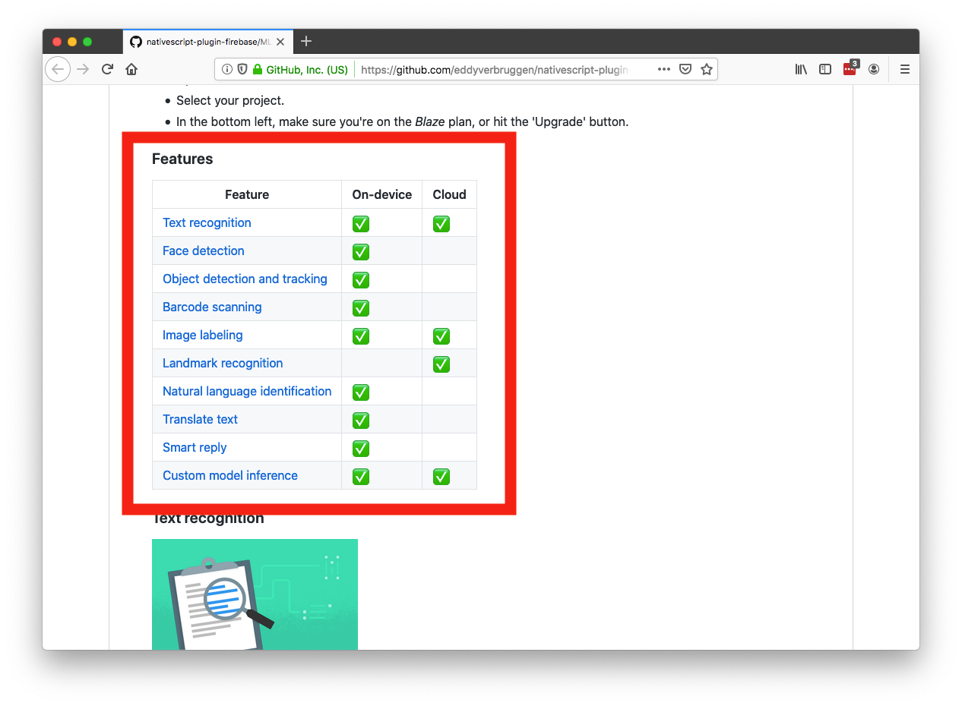

Slide 52
Machine learning resources
Plugin
https://github.com/EddyVerbruggen/nativescript-plugin-firebase
Talk
https://www.youtube.com/watch?v=dONJ2fj6iqc

Slide 53
#10: AR
Augmented Reality (AR) is the integration of digital information with the user’s environment in real time.

Slide 54
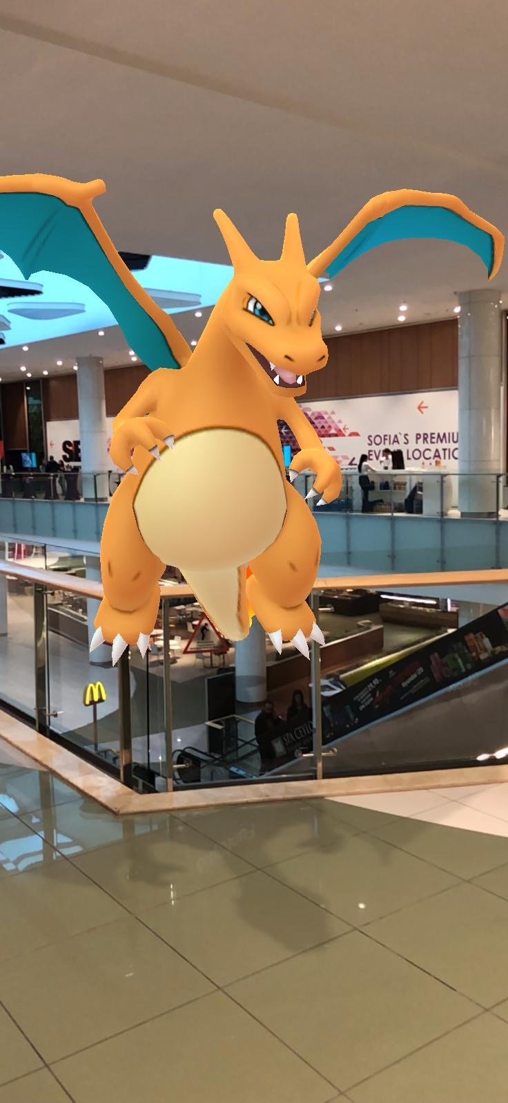

Slide 55
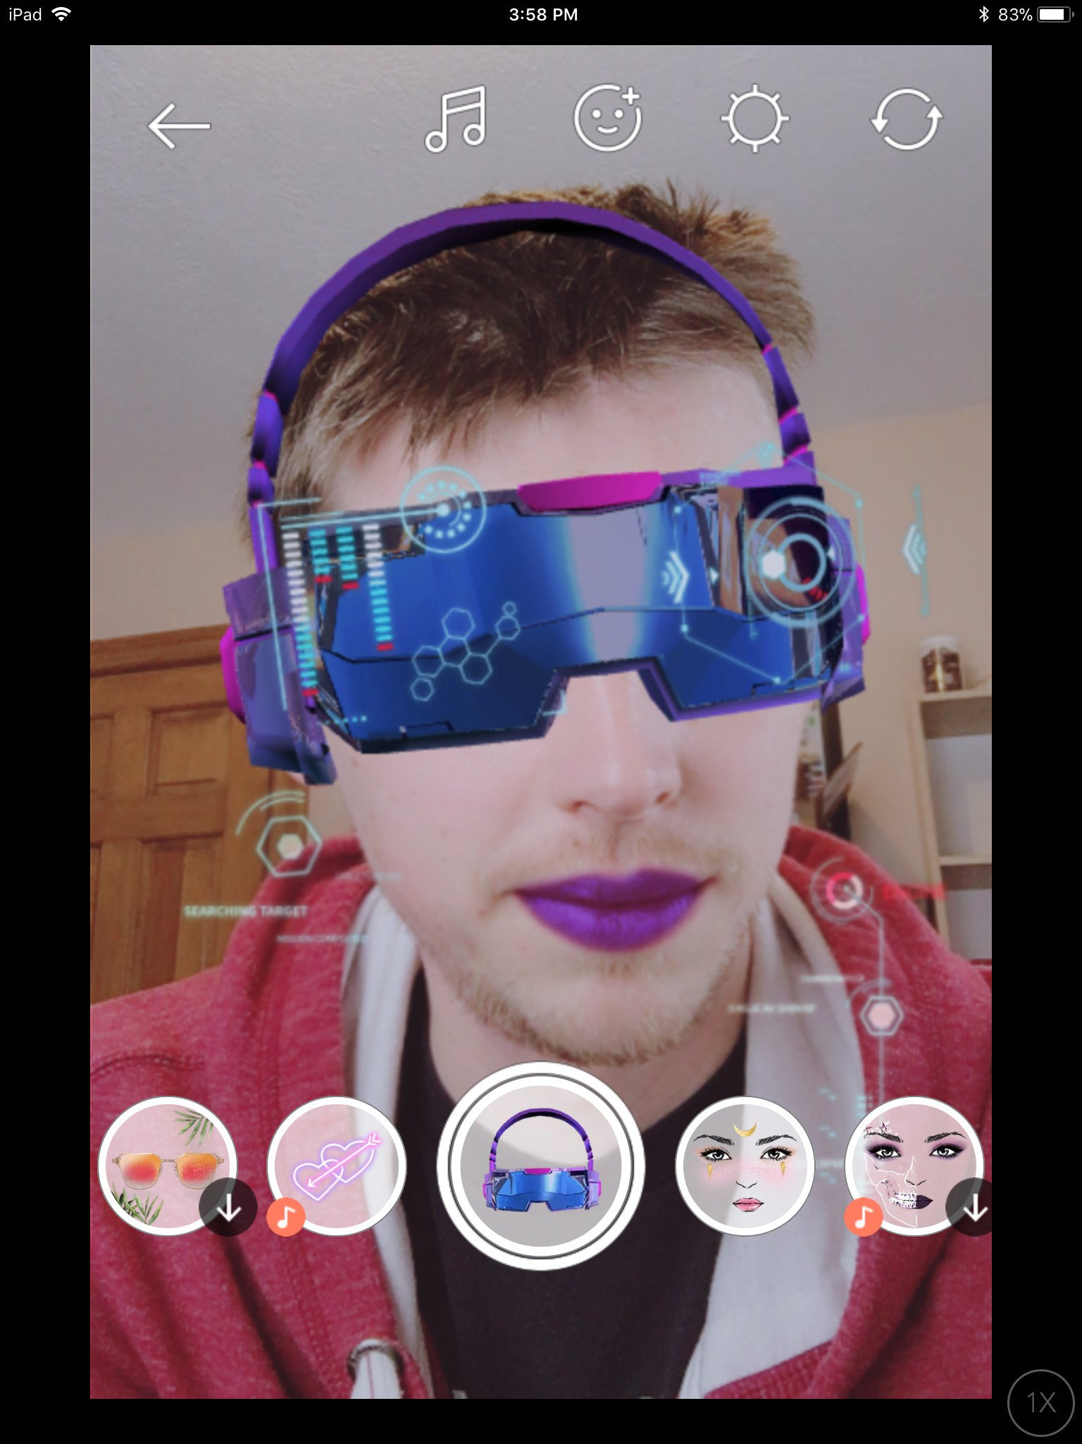



Slide 56
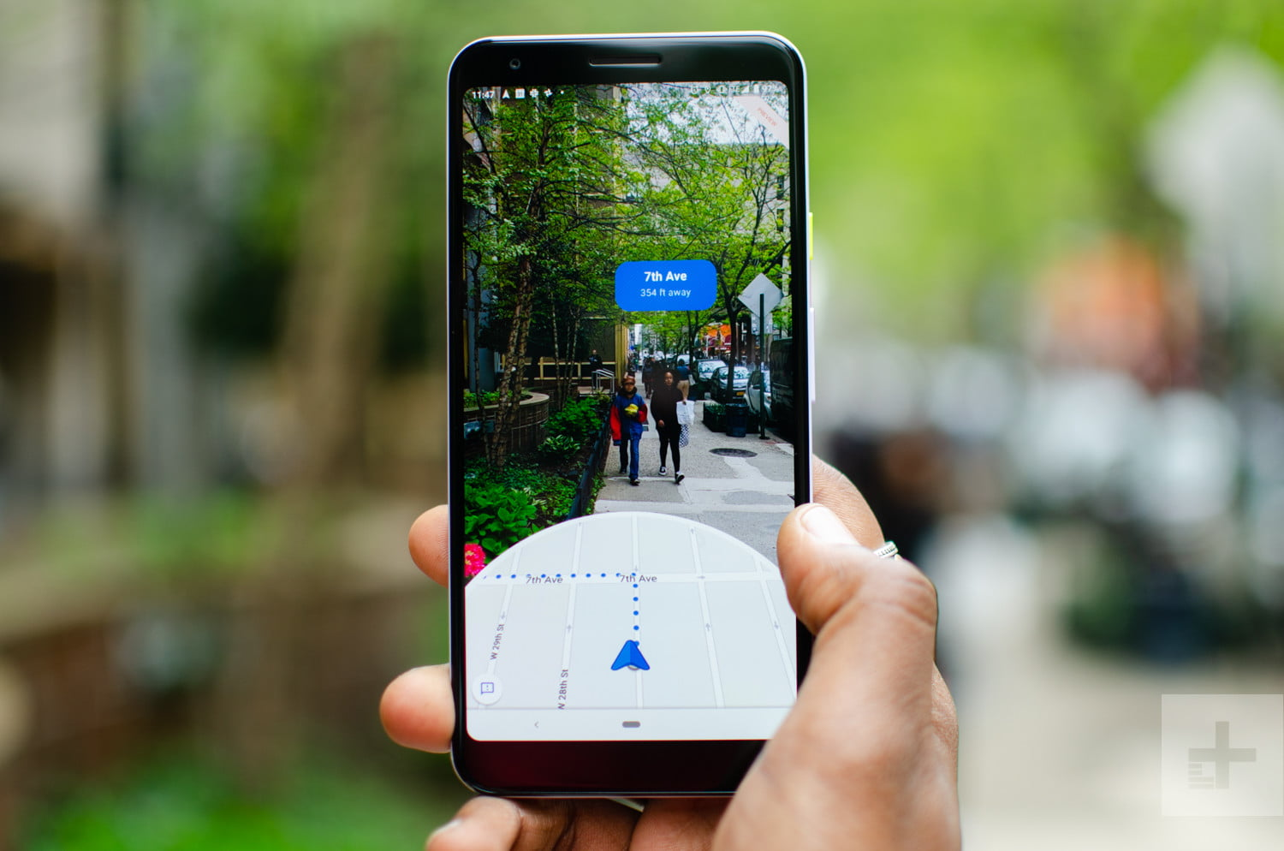

Slide 57
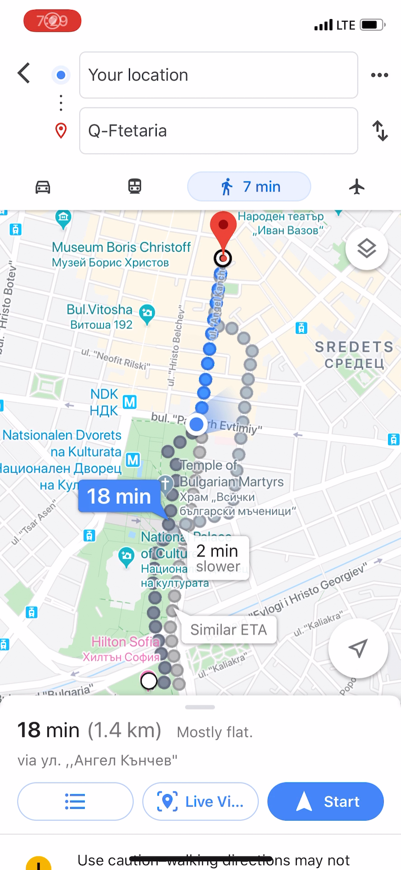

Slide 58
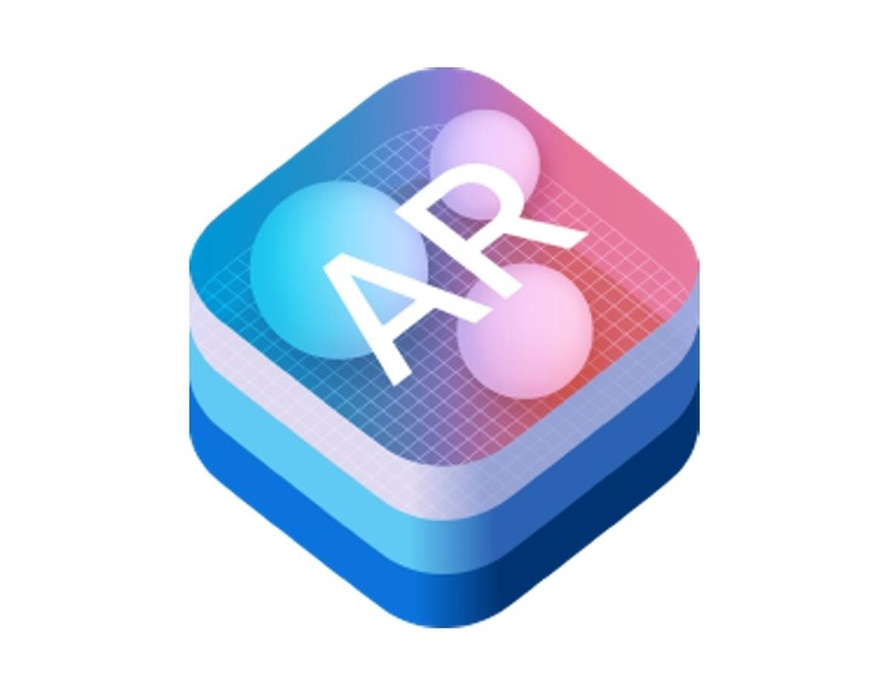

ARKit
ARCore

Slide 59
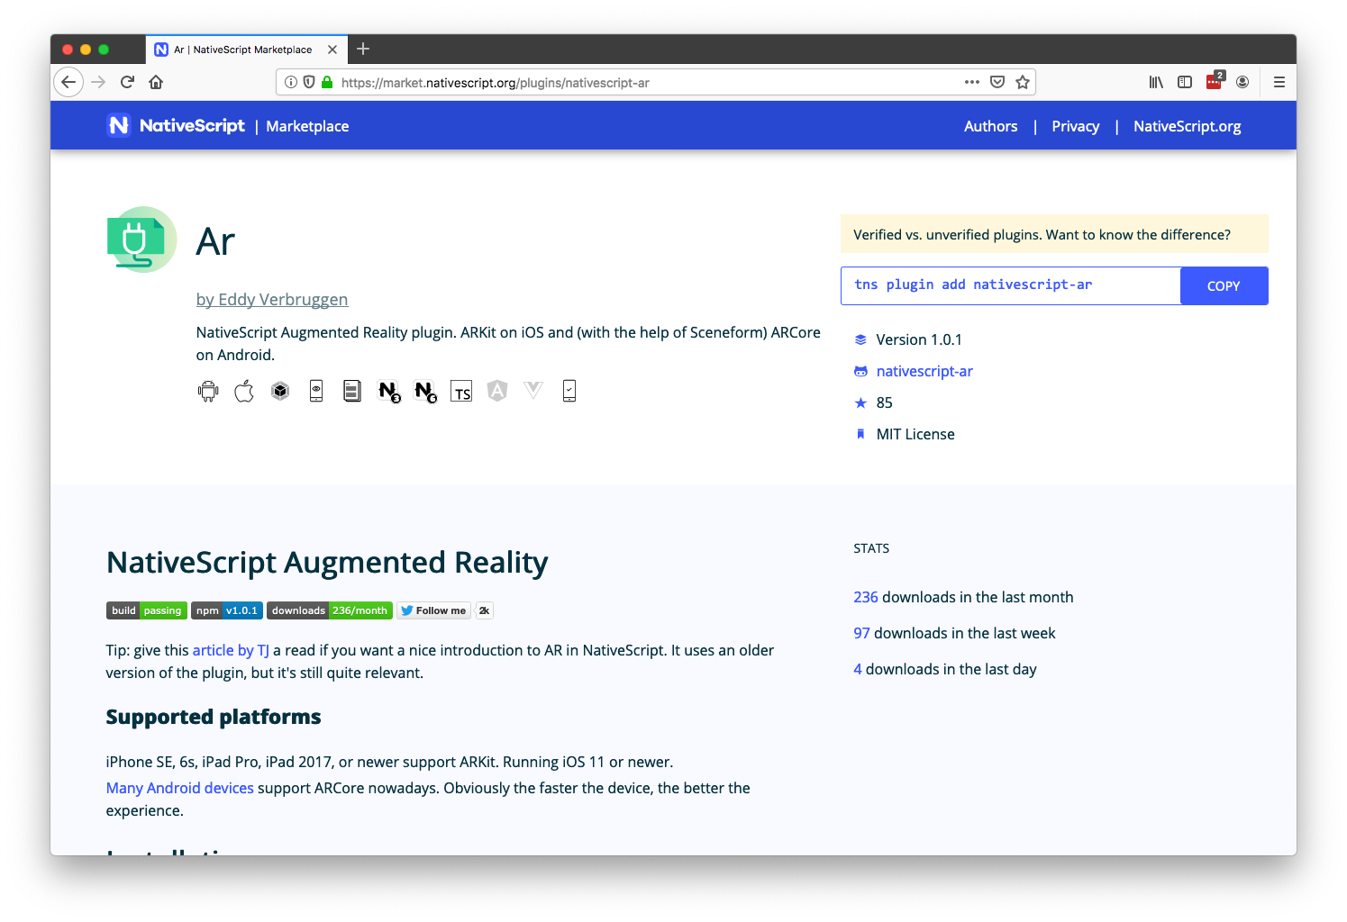

Slide 60
Augmented reality resources
Plugin
https://market.nativescript.org/plugins/nativescript-ar
Article
https://www.nativescript.org/blog/getting-started-with-augmented-reality-in-nativescript
Talk
https://www.youtube.com/watch?v=8Aw3aJDEYPI

Slide 61
Agenda
Pragmatic
Biometric Auth, Maps & Geolocation, Code Sharing, Animations
Useful
AppSync, Bluetooth, Wearables, Native API access
Fun
Machine Learning, AR

Slide 62
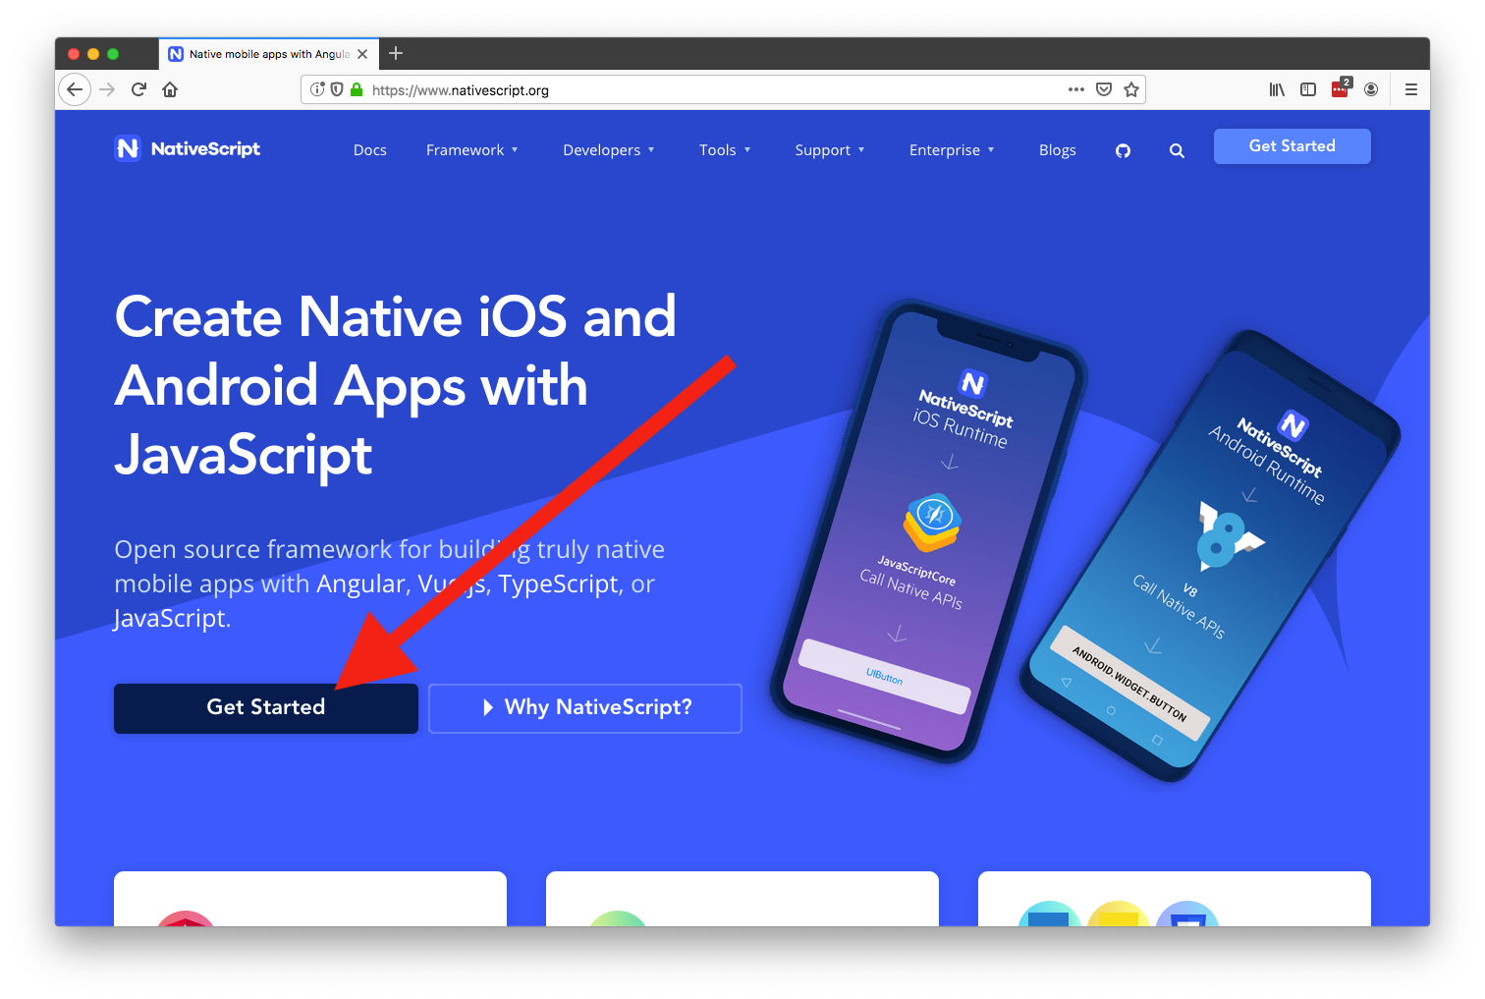

Slide 63

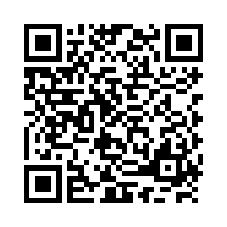
Thanks!
@tjvantoll
Session Feedback Your Time & Opinion is Valued
Slides: http://bit.ly/top-10-slides
Demo: http://bit.ly/top-10-demo
https://www.telerik.com/devreach/day1feedback

